Slide 1

8th Grade Math: Pre-Algebra
Unit 10, Lesson 2 Identifying Domain and Range Volume 2, pg. 124

Slide 2


Benchmark
MA.8.F.1.1
Given a set of ordered pairs, a table, a graph, or mapping diagram, determine whether the relationship is a function. Identify the domain and range of the relation.
volume 2, pg. 124

Slide 3
Integrated Mathematical Thinking and Reasoning Standards
MA.K12.MTR.2.1 Demonstrate understanding by representing problems in multiple ways.
MA.K12.MTR.7.1 Apply mathematics to real-world contexts.
volume 2, pg. 124

Slide 4

Learning Targets
I can relate domain and range to independent and dependent variables in a relation.
I can identify the domain and range of a relation.
volume 2, pg. 124

Slide 5

Warm-Up
volume 2, pg. 124

Slide 6
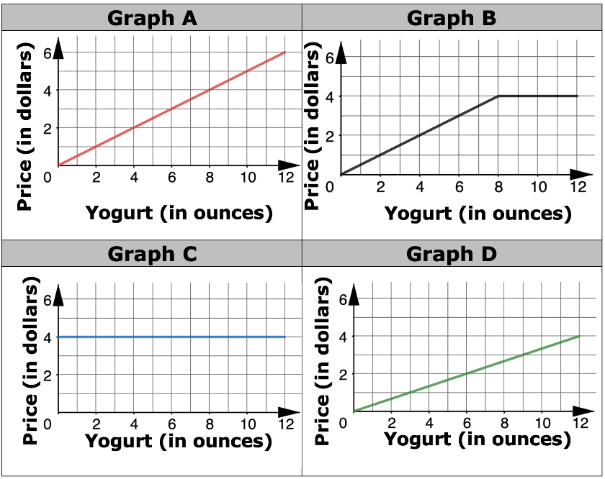

10.2.1 Warm-Up: Math Talk
A self-serve frozen yogurt store sells servings up to $12$ ounces. It charges $\$0.50$ per ounce for a serving between $0$ and $8$ ounces, and $\$4.00$ for any serving greater than $8$ ounces and up to $12$ ounces. Four graphs are shown.
Explain which graph best represents the price as a function of the weight of a serving of yogurt.
volume 2, pg. 124

Slide 7

Guided Instruction
volume 2, pg.125

Slide 8
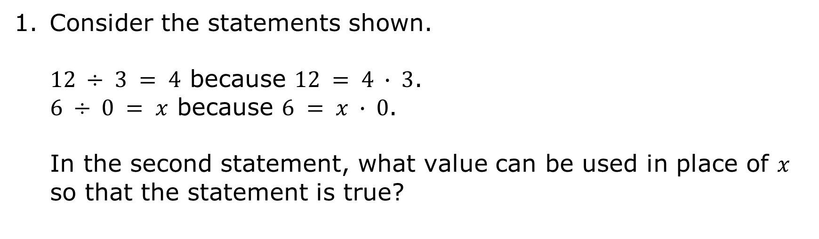
10.2.2 Guided Instruction: Identifying the Domain and Range of a Relation
Consider the statements shown.
$12 ÷ 3 = 4$ because $12 = 4 ∙ 3$.
$6 ÷ 0 = x$ because $6 = x ∙ 0$.
In the second statement, what value can be used in place of $x$ so that the statement is true?
volume 2, pg.125

Slide 9

The inputs of a relation are described as its domain.
The domain is the complete set of possible values of the input of a function or relation. The domain may vary depending on the context.
Sometimes one or more values are not allowed in the domain.
volume 2, pg.125

Slide 10
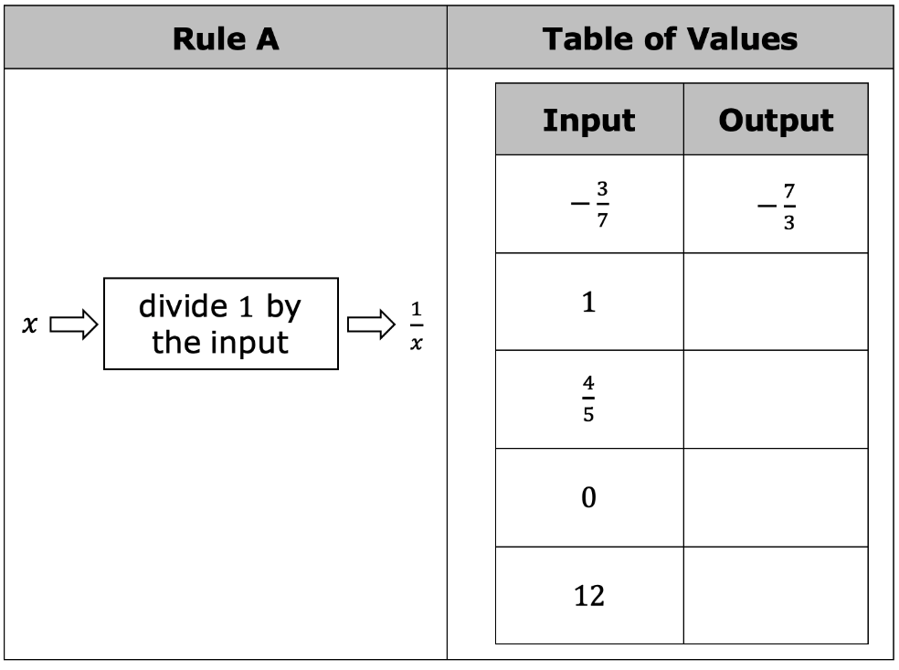
Use the rule to complete the table of values to represent the relation described by the rule and answer the subsequent questions.
Complete the table of values.
volume 2, pg.125

Slide 11
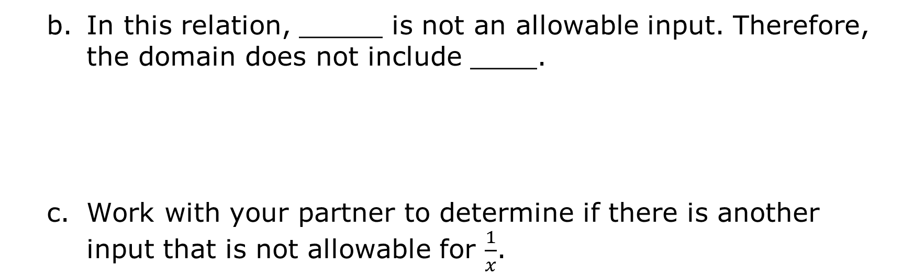
In this relation, _____ is not an allowable input. Therefore, the domain does not include ____.
Work with your partner to determine if there is another input that is not allowable for $\frac{1}{x}$.
volume 2, pg.125

Slide 12
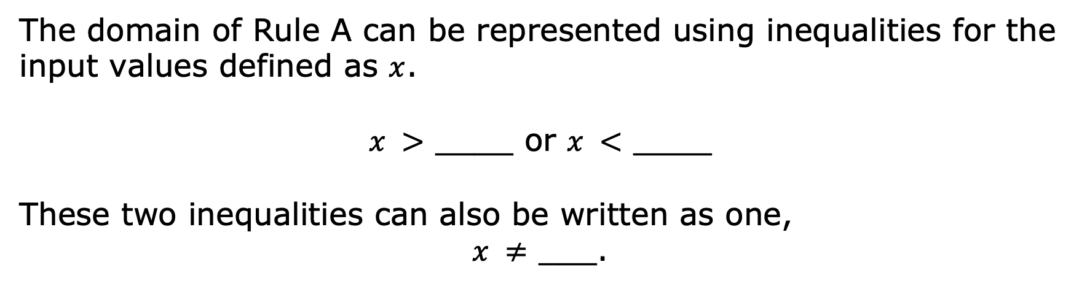
The domain of Rule A can be represented using inequalities for the input values defined as $x$.
$x >$ ­­____ or $x <$ ____
These two inequalities can also be written as one,
$x ≠$ ___.
The outputs of a relation are described as its range.
The range is the complete set of possible values of the output of a relation or function.
volume 2, pg.126

Slide 13
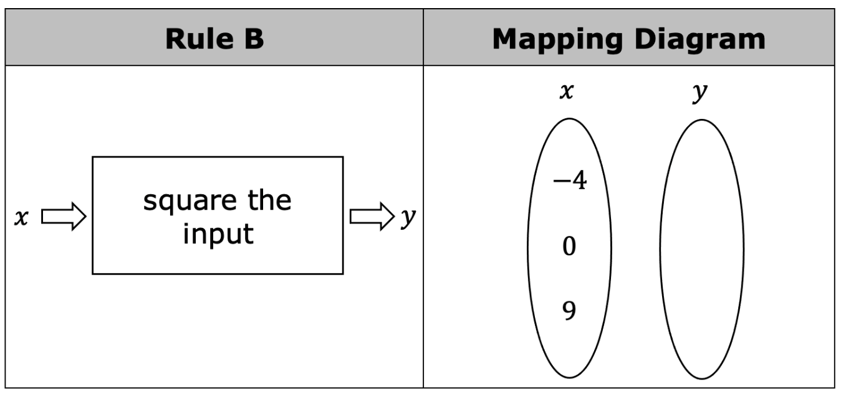
Use the rule to complete the mapping diagram and answer the subsequent questions.
Complete the mapping diagram.
volume 2, pg.126

Slide 14
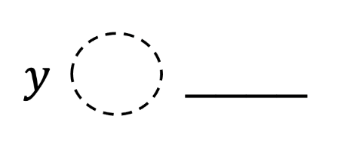
Based on the rule, what type of output values are unattainable for this relation?
Write an inequality to represent the range of this relation.
At times, the domain and range of a relation can be represented using a list of numbers.
volume 2, pg.126

Slide 15
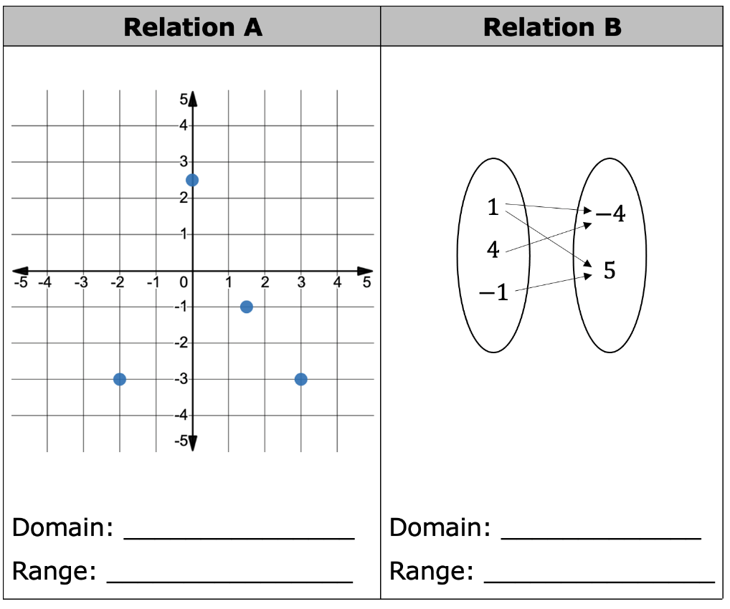
For each relation, write the domain and range as a set of numbers.
volume 2, pg.127

Slide 16
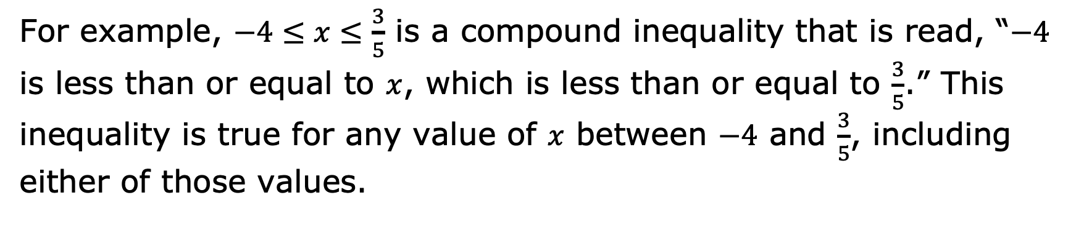
There are also instances where the domain and range of a relation can be represented by a compound inequality.
A compound inequality is a conjunction of two or more inequalities.
For example, $−4≤x≤\frac{3}{5}$ is a compound inequality that is read, “$−4$ is less than or equal to $x$, which is less than or equal to $\frac{3}{5}$.” This inequality is true for any value of $x$ between $−4$ and $\frac{3}{5}$, including either of those values.
volume 2, pg.127

Slide 17
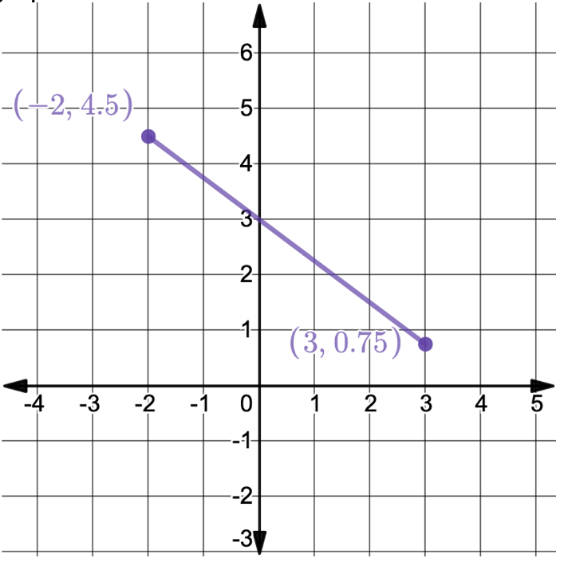
A graph is shown.
Represent the domain and range of the graph using compound inequalities.
Domain: ___________
Range: ____________
Compare this graph to Relation A in the previous problem. Discuss with your partner why representing the domain and range of this graph could not be done by writing the elements of each in a list.
volume 2, pg.127

Slide 18

Representing Domain and Range
When the elements of the domain or range consist of a set number of values, each can be represented by a list.
When the elements of the domain or range consist of an infinite number of points between specified values, an inequality is best.
volume 2, pg.128

Slide 19

Try It
volume 2, pg.128

Slide 20

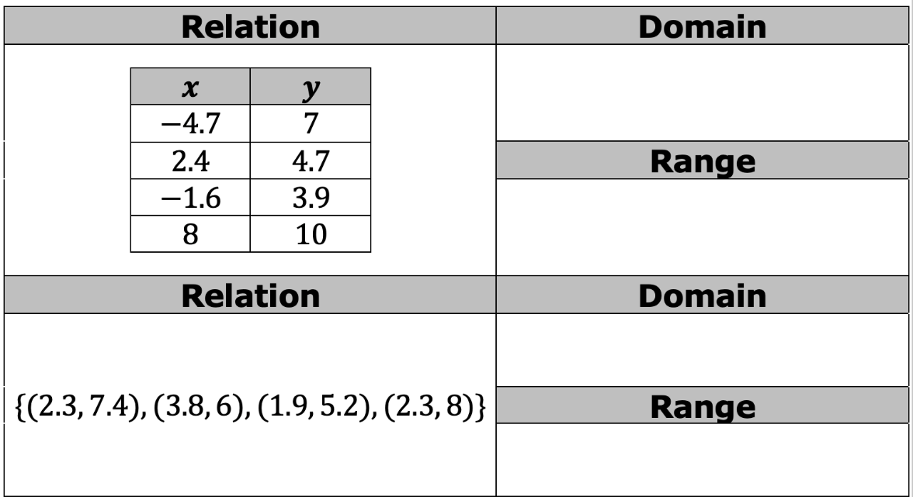
10.2.3 Try It: Identifying the Domain and Range of a Relation
1. Identify the domain and range of each relation. Represent the domain as a list or using an inequality.
volume 2, pg.128

Slide 21
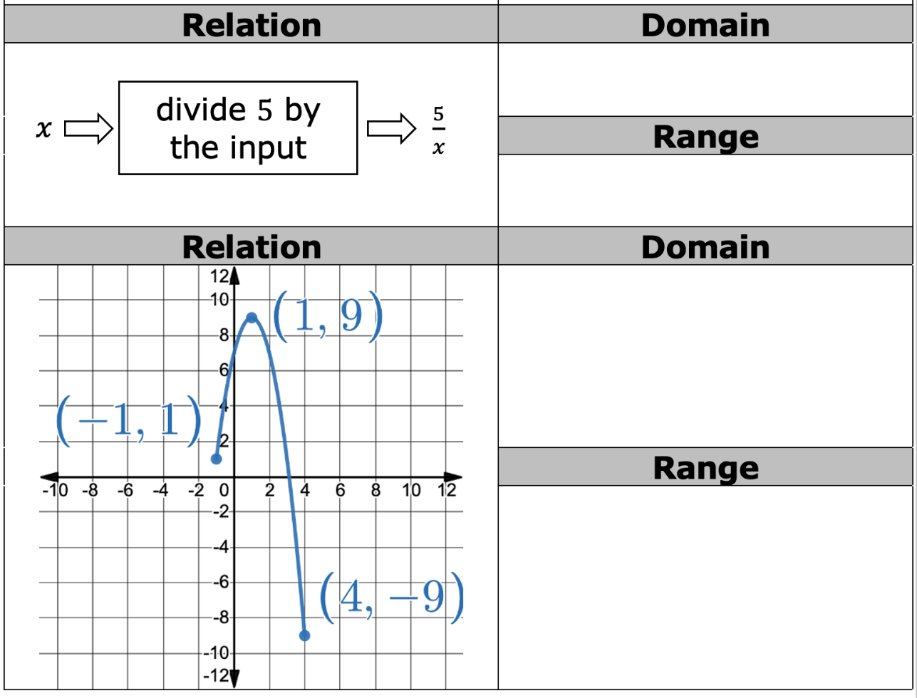
volume 2, pg.128

Slide 22

Wrap-Up
volume 2, pg.129

Slide 23
10.2.4 Wrap-Up: Growth Mindset
Complete each statement.
Today I am still unsure about…
To fill this gap, I intend to…
volume 2, pg.129

